Slide 1
Statistics with Spa ows
Lecture 10
Julia Schroeder
Julia.schroeder@imperial.ac.uk

Slide 2
Outline
Hypothesis testing in linear models
Interpretation (a bit)
Standardizing
Reporting

Slide 3
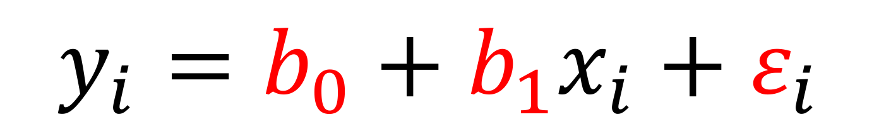
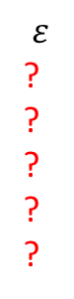
Hypothesis testing in linear models
What do we actually test?
$$y_{i}=b_{0}+b_{1}x_{i}+ε_{i}$$
y
5
3
6
11
0
i
1
2
3
4
5
x
3
1
4
8
2
i
1
2
3
4
5
$$ε$$
?
?
?
?
?
i
1
2
3
4
5
b₀ = ?
b₁ = ?

Slide 4
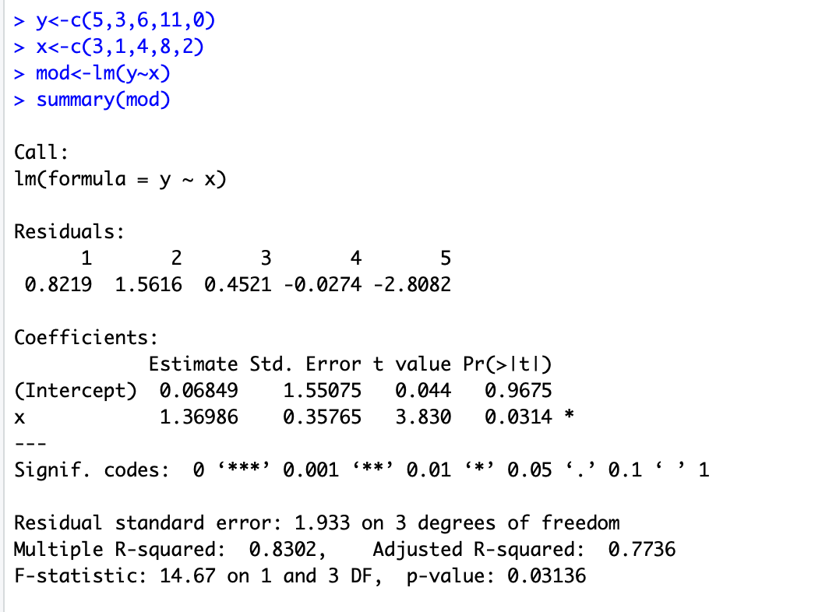

Slide 5
We tested whether the SS of a straight line with slope 0 (b₁ = 0) was different from the line we guesstimated, with a different slope

Slide 6
We tested whether the SS of a straight line with slope 0 (b₁ = 0) was different from the line we guesstimated, with a different slope
Test if slope (b₁) estimate is different from 0
T-test!

Slide 8
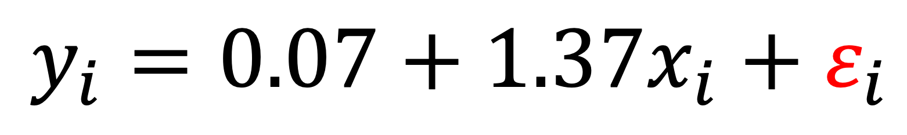

Hypothesis testing in linear models
Predicted values:
$$y_{i}=0.07+1.37x_{i}+ε_{i}$$
y
5
3
6
11
0
x
3
1
4
8
2
$$ε$$
?
?
?
?
?
i
1
2
3
4
5
5 = 0.07 + 1.37 * 3 + e
3 = 0.07 + 1.37 * 1 + e
6 = 0.07 + 1.37 * 4 + e
11 = 0.07 + 1.37 * 8 + e
0 = 0.07 + 1.37 * 2 + e

Slide 9
Hypothesis testing in linear models
Predicted values:
$$y_{i}=0.07+1.37x_{i}+ε_{i}$$
y
5
3
6
11
0
x
3
1
4
8
2
$$ε$$
?
?
?
?
?
i
1
2
3
4
5
5 = 0.07 + 1.37 * 3 -0.82
3 = 0.07 + 1.37 * 1 + e
6 = 0.07 + 1.37 * 4 + e
11 = 0.07 + 1.37 * 8 + e
0 = 0.07 + 1.37 * 2 + e

Slide 10
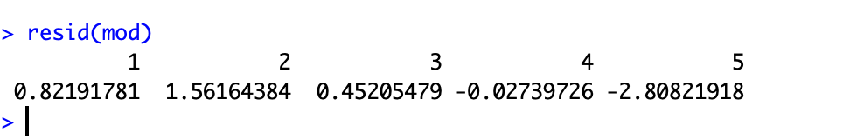
Hypothesis testing in linear models
Predicted values:
$$y_{i}=0.07+1.37x_{i}+ε_{i}$$
y
5
3
6
11
0
x
3
1
4
8
2
$$ε$$
?
?
?
?
?
i
1
2
3
4
5
5 = 0.07 + 1.37 * 3 -0.82
3 = 0.07 + 1.37 * 1 + e
6 = 0.07 + 1.37 * 4 + e
11 = 0.07 + 1.37 * 8 + e
0 = 0.07 + 1.37 * 2 + e

Slide 11
Hypothesis testing in linear models
Predicted values:
$$y_{i}=0.07+1.37x_{i}+ε_{i}$$
y
5
3
6
11
0
x
3
1
4
8
2
$$ε$$
?
?
?
?
?
i
1
2
3
4
5
5 = 0.07 + 1.37 * 3 -0.82
3 = 0.07 + 1.37 * 1 + 1.56
6 = 0.07 + 1.37 * 4 + 0.45
11 = 0.07 + 1.37 * 8 – 0.03
0 = 0.07 + 1.37 * 2 – 2.81

Slide 12
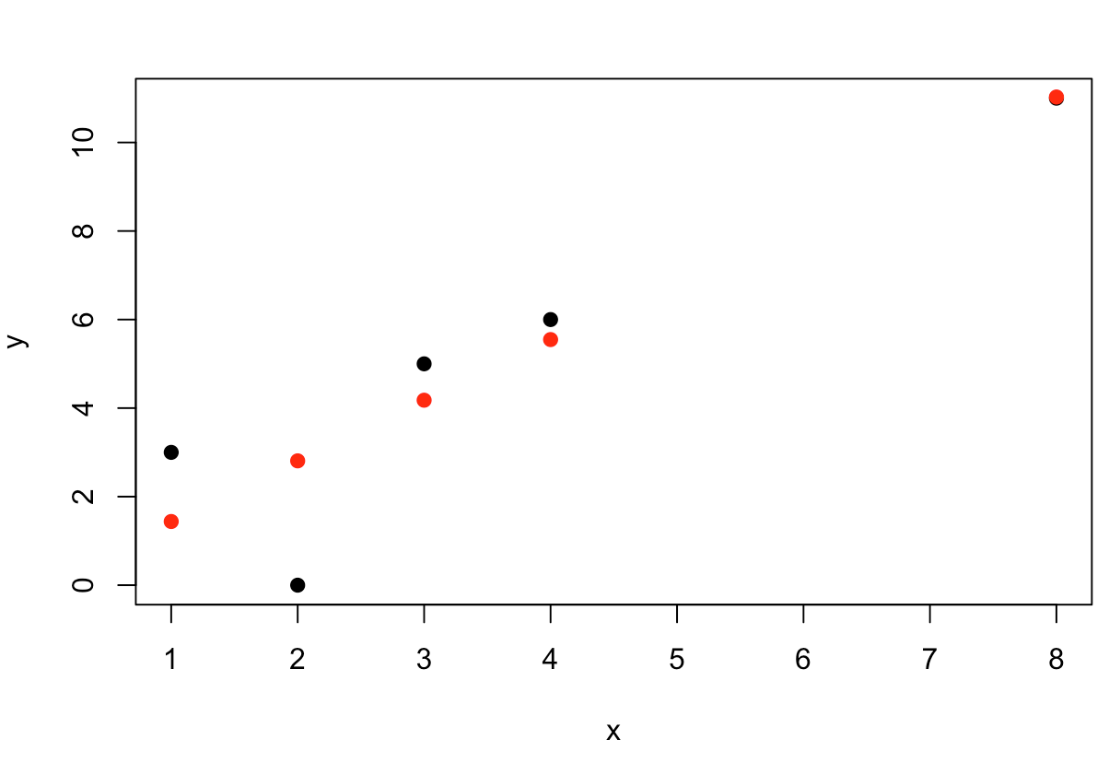
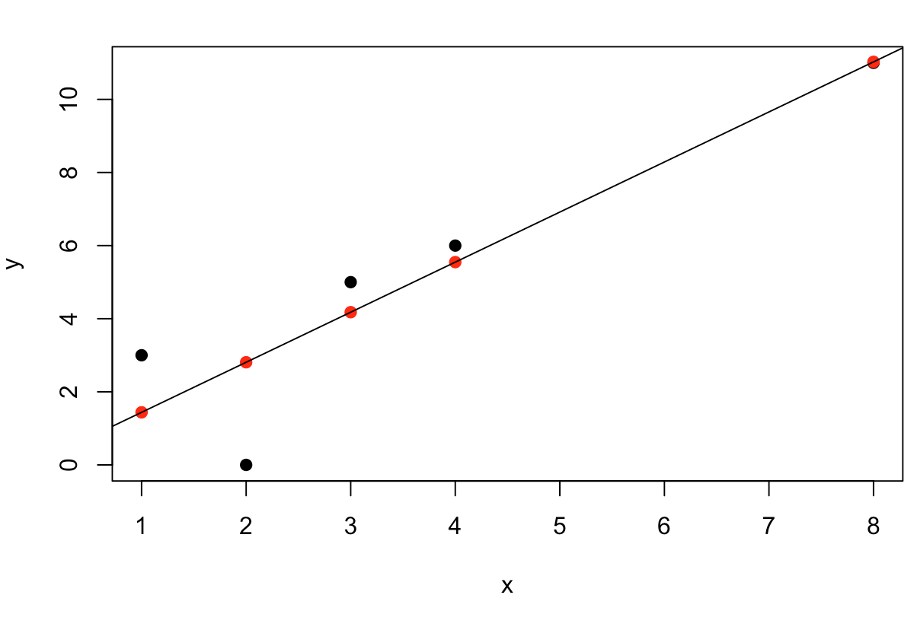
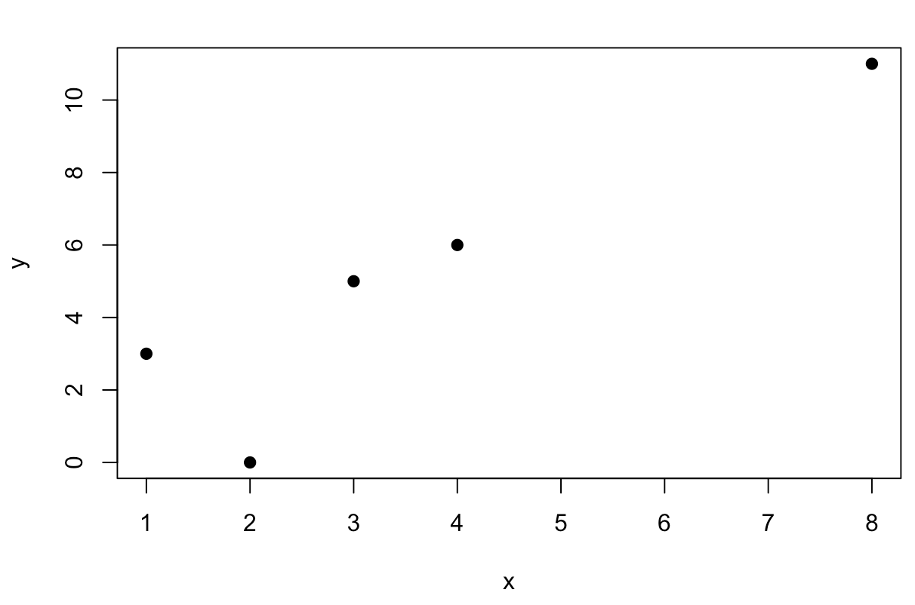
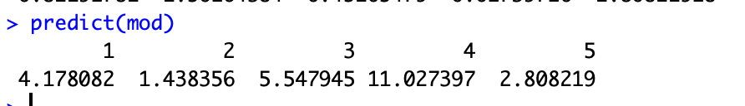
y
5
3
6
11
0
x
3
1
4
8
2
Y predicted
4.18
1.44
5.55
11.03
2.81

Slide 13
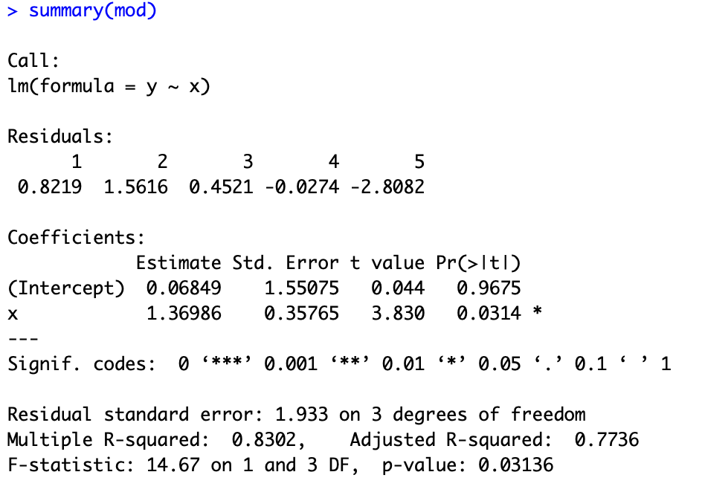
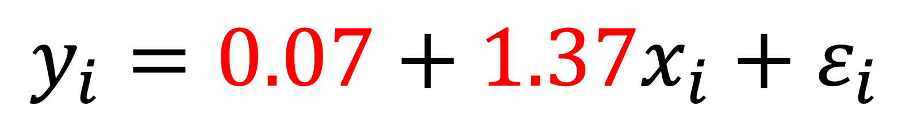
Hypothesis testing in linear models
Measure precision of estimates:
$$y_{i}=0.07+1.37x_{i}+ε_{i}$$

Slide 14
Inference
Tests null hypotheses that
b₀ = 0
b₁ = 0
What does it mean if the null hypothesis is rejected?

Slide 15
Inference
Tests null hypotheses that
b₀ = 0
b₁ = 0
What does it mean if the null hypothesis is rejected?
Usually not much for b₀
The slope is b₁, this gives information about the relationship between y and x.

Slide 16
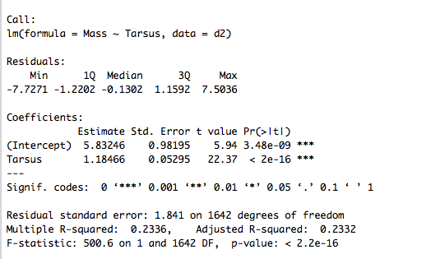
Inference
Tests null hypotheses that
b₀ = 0, rejected!
b₁ = 0, rejected!

Slide 17
Inference
Tests null hypotheses that
b₀ = 0, rejected!
b₁ = 0, rejected!
The intercept (where Tarsus = 0) is 5.8. A bird with no tarsus would weigh 5.8g.

Slide 18
Inference
Tests null hypotheses that
b₀ = 0, rejected!
b₁ = 0, rejected!
The intercept (where Tarsus = 0) is 5.8. A bird with no tarsus would weigh 5.8g.
The slope is 5.8
For each mm longer tarsus, a sparrow weights 1.18g more.

Slide 19
Why standardize data?

Slide 20
Why standardize data?

Slide 21
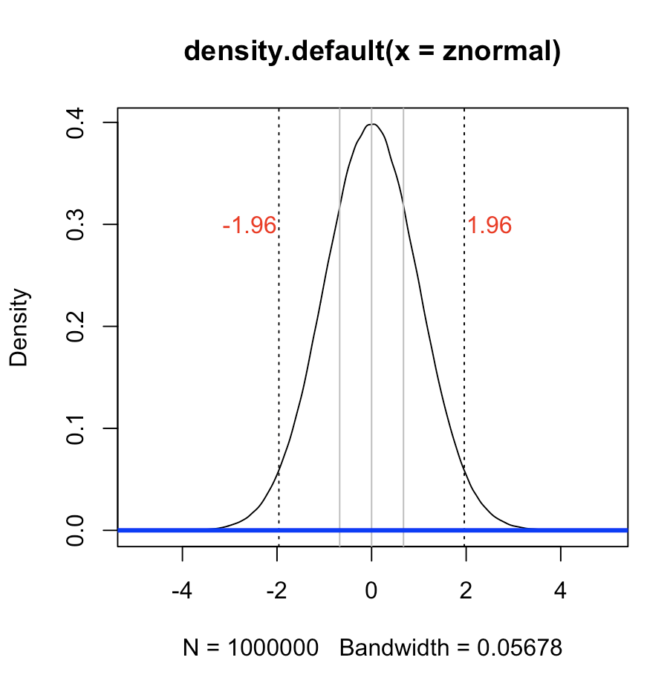
Why standardize data?
z-scores:
Normal distributed
Mean of 0
Sd of 1

Slide 22
Why standardize data?

Slide 23
Why standardize data?
(black: mm, red: z-standardized)

Slide 24
Why standardize data?
(black: mm, red: z-standardized)

Slide 25
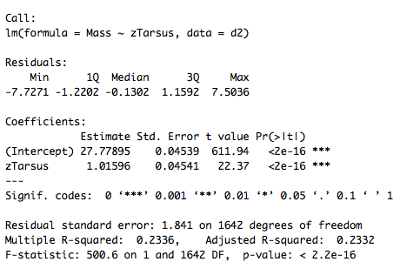
Why standardize data?
(black: mm, red: z-standardized)

Slide 26
Why standardize data?
Intercept becomes meaningful!
It’s the mean of y!
(black: mm, red: z-standardized)

Slide 27
Why standardize data?
Intercept becomes meaningful!
It’s the mean of y!
(black: mm, red: z-standardized)

Slide 28
Why standardize data?
Also, units. What if we’d measured tarsus in cm?
d2$Tarsuscm<-d2$Tarsus*10

Slide 29
Why standardize data?
Also, units. What if we’d measured tarsus in cm?
d2$Tarsuscm<-d2$Tarsus*10
Model4<-lm(Mass~Tarsuscm,data=d2)

Slide 30
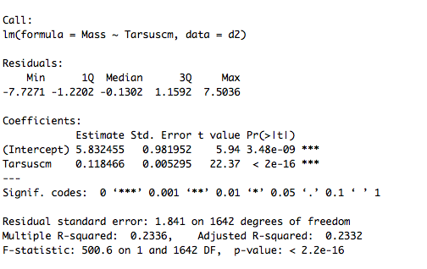
Why standardize data?
Also, units. What if we’d measured tarsus in cm?
d2$Tarsuscm<-d2$Tarsus*10
Model4<-lm(Mass~Tarsuscm,data=d2)

Slide 31
Why standardize data?
Also, units. What if we’d measured tarsus in cm?
d2$Tarsuscm<-d2$Tarsus*10
Model4<-lm(Mass~Tarsuscm,data=d2)

Slide 32
Interpretation of statistics – take home
Always consider units!
Standardize to make intercept meaningful
T-tests test for null hypothesis that parameter estimates equal –
Always think of the biological meaning in units!

Slide 33
How to report?
Methods:
To test whether heavier birds also had longer tarsi, I used a linear model, where body mass (g) was the response variable, and tarsus length (mm) the explanatory variable. I z-standardized tarsus length so that the intercept could be interpreted as the mean of body mass. Following the analysis, I used visual inspection of residual plots to assess that the assumption that the residuals follow a normal distribution was not violated. I report results as statistically significant if p equals or is smaller than 0.05. I used R version 3.3 (R Core Team 2015) for all analysis and plotting.

Slide 34
How to report?
Methods:
To test whether heavier birds also had longer tarsi, I used a linear model, where body mass (g) was the response variable, and tarsus length (mm) the explanatory variable. I z-standardized tarsus length to a mean of 0 and SD of one, so that the intercept could be interpreted as the mean of body mass. Following the analysis, I used visual inspection of residual plots to assess that the assumption that the residuals follow a normal distribution was not violated. I report results as statistically significant if p equals or is smaller than 0.05. I used R version 3.3 (R Core Team 2015) for all analysis and plotting.

Slide 35
How to report?
Methods:
To test whether heavier birds also had longer tarsi, I used a linear model, where body mass (g) was the response variable, and tarsus length (mm) the explanatory variable. I z-standardized tarsus length to a mean of 0 and SD of one, so that the intercept could be interpreted as the mean of body mass. Following the analysis, I used visual inspection of residual plots to assess that the assumption that the residuals follow a normal distribution was not violated. I report results as statistically significant if p equals or is smaller than 0.05. I used R version 3.3 (R Core Team 2015) for all analysis and plotting.

Slide 36
How to report?
Methods:
To test whether heavier birds also had longer tarsi, I used a linear model, where body mass (g) was the response variable, and tarsus length (mm) the explanatory variable. I z-standardized tarsus length to a mean of 0 and SD of one, so that the intercept could be interpreted as the mean of body mass. Following the analysis, I used visual inspection of residual plots to assess that the assumption that the residuals follow a normal distribution was not violated. I report results as statistically significant if p equals or is smaller than 0.05. I used R version 3.3 (R Core Team 2015) for all analysis and plotting.

Slide 37
How to report?
Results:
I used data from 1646 observations. The sparrows weighed on average 27.78 g (SD 2.10, range: 18.60–36.20). The tarsi of the sparrows were on average 18.5mm long (SD 0.86, range: 15.00–21.10). I found a positive, statistically significant association between mass and tarsus. An increase in 1SD Tarsus length meant an increase of 1.02g in body mass (Table 1).

Slide 38
How to report?
Results:
I used data from 1646 observations. The sparrows weighed on average 27.78 g (SD 2.10, range: 18.60–36.20). The tarsi of the sparrows were on average 18.5mm long (SD 0.86, range: 15.00–21.10). I found a positive, statistically significant association between mass and tarsus. An increase in 1SD Tarsus length meant an increase of 1.02g in body mass (Table 1).

Slide 39
How to report?
Results:
I used data from 1646 observations. The sparrows weighed on average 27.78 g (SD 2.10, range: 18.60–36.20). The tarsi of the sparrows were on average 18.5mm long (SD 0.86, range: 15.00–21.10). I found a positive, statistically significant association between mass and tarsus. An increase in 1SD Tarsus length meant an increase of 1.02g in body mass (Table 1).

Slide 40
How to report?
Results:
I used data from 1646 observations. The sparrows weighed on average 27.78 g (SD 2.10, range: 18.60–36.20). The tarsi of the sparrows were on average 18.5mm long (SD 0.86, range: 15.00–21.10). I found a positive, statistically significant association between mass and tarsus (Table 1). An increase in 1SD Tarsus length meant an increase of 1.02g in body mass.

Slide 41
How to report?
Results:
I used data from 1646 observations. The sparrows weighed on average 27.78 g (SD 2.10, range: 18.60–36.20). The tarsi of the sparrows were on average 18.5mm long (SD 0.86, range: 15.00–21.10). I found a positive, statistically significant association between mass and tarsus (Table 1). An increase in 1SD Tarsus length meant an increase of 1.02g in body mass.

Slide 42
How to report?
Results:
I used data from 1646 observations. The sparrows weighed on average 27.78 g (SD 2.10, range: 18.60–36.20). The tarsi of the sparrows were on average 18.5mm long (SD 0.86, range: 15.00–21.10). I found a positive, statistically significant association between mass and tarsus (Table 1). An increase in 1SD Tarsus length meant an increase of 1.02g in body mass.
Table 1: Results from a linear model explaining body mass of Lundy sparrows with tarsus length. Tarsus length was z-standardized. N = 1646.
Variable | b | SE | t | p
Intercept | 27.78 | 0.05 | 611.94 | <0.001
Tarsus | 1.02 | 0.05 | 22.37 | <0.001

Slide 43
How to report?
Clear headers!
Headers of columns center aligned!
Results:
I used data from 1646 observations. The sparrows weighed on average 27.78 g (SD 2.10, range: 18.60–36.20). The tarsi of the sparrows were on average 18.5mm long (SD 0.86, range: 15.00–21.10). I found a positive, statistically significant association between mass and tarsus (Table 1). An increase in 1SD Tarsus length meant an increase of 1.02g in body mass.
Table 1: Results from a linear model explaining body mass of Lundy sparrows with tarsus length. Tarsus length was z-standardized. N = 1646.
Variable | b | SE | t | p
Intercept | 27.78 | 0.05 | 611.94 | <0.001
Tarsus | 1.02 | 0.05 | 22.37 | <0.001

Slide 44
How to report?
Clear headers!
Headers of columns center aligned!
Always report all variables in the model. Don’t be selective!
Right align first column!
Results:
I used data from 1646 observations. The sparrows weighed on average 27.78 g (SD 2.10, range: 18.60–36.20). The tarsi of the sparrows were on average 18.5mm long (SD 0.86, range: 15.00–21.10). I found a positive, statistically significant association between mass and tarsus (Table 1). An increase in 1SD Tarsus length meant an increase of 1.02g in body mass.
Table 1: Results from a linear model explaining body mass of Lundy sparrows with tarsus length. Tarsus length was z-standardized. N = 1646.
Variable | b | SE | t | p
Intercept | 27.78 | 0.05 | 611.94 | <0.001
Tarsus | 1.02 | 0.05 | 22.37 | <0.001

Slide 45
How to report?
Clear headers!
Headers of columns center aligned!
Always report all variables in the model. Don’t be selective!
Right align first column!
Left align numbers!
Round to two digits (or what else is biologically reasonable)!
Always report parameter estimates (b)
Results:
I used data from 1646 observations. The sparrows weighed on average 27.78 g (SD 2.10, range: 18.60–36.20). The tarsi of the sparrows were on average 18.5mm long (SD 0.86, range: 15.00–21.10). I found a positive, statistically significant association between mass and tarsus (Table 1). An increase in 1SD Tarsus length meant an increase of 1.02g in body mass.
Table 1: Results from a linear model explaining body mass of Lundy sparrows with tarsus length. Tarsus length was z-standardized. N = 1646.
Variable | b | SE | t | p
Intercept | 27.78 | 0.05 | 611.94 | <0.001
Tarsus | 1.02 | 0.05 | 22.37 | <0.001

Slide 46
How to report?
Clear headers!
Headers of columns center aligned!
Always report all variables in the model. Don’t be selective!
Right align first column!
Left align numbers!
Round to two digits (or what else is biologically reasonable)!
Always report parameter estimates (b)
Report meaningful p-values (no e-16 bs or similar)!
Results:
I used data from 1646 observations. The sparrows weighed on average 27.78 g (SD 2.10, range: 18.60–36.20). The tarsi of the sparrows were on average 18.5mm long (SD 0.86, range: 15.00–21.10). I found a positive, statistically significant association between mass and tarsus (Table 1). An increase in 1SD Tarsus length meant an increase of 1.02g in body mass.
Table 1: Results from a linear model explaining body mass of Lundy sparrows with tarsus length. Tarsus length was z-standardized. N = 1646.
Variable | b | SE | t | p
Intercept | 27.78 | 0.05 | 611.94 | <0.001
Tarsus | 1.02 | 0.05 | 22.37 | <0.001

Slide 47
How to report?
Clear headers!
Headers of columns center aligned!
Always report all variables in the model. Don’t be selective!
Right align first column!
Left align numbers!
Round to two digits (or what else is biologically reasonable)!
Always report parameter estimates (b)
Report meaningful p-values (no e-16 bs or similar)!
Table legend goes on top of tables (below figures)
Table legend should be self-explanatory without refering to text!
Results:
I used data from 1646 observations. The sparrows weighed on average 27.78 g (SD 2.10, range: 18.60–36.20). The tarsi of the sparrows were on average 18.5mm long (SD 0.86, range: 15.00–21.10). I found a positive, statistically significant association between mass and tarsus (Table 1). An increase in 1SD Tarsus length meant an increase of 1.02g in body mass.
Table 1: Results from a linear model explaining body mass of Lundy sparrows with tarsus length. Tarsus length was z-standardized. N = 1646.
Variable | b | SE | t | p
Intercept | 27.78 | 0.05 | 611.94 | <0.001
Tarsus | 1.02 | 0.05 | 22.37 | <0.001

Slide 48
How to report – take home
Methods:
Always describe *all analyses you present in results. Be precise and specific. Describe what’s the response variable. Say what is the explanatory variable, and say WHY you used those. Give the units. Say when you standardize, and WHY.
Justify, justify, justify.

Slide 49
How to report – take home
Results:
Start with describing the dataset.
Sample size, mean, range, missing values ect.
Explain results of each analysis
Make nice tables and think before copy/pasting values from R!
Legends need be self-explanatory!

